Slide 1
Big Data – Big Data Fundamentals Week 2
Professor Arturo Castellanos, PhD
Assistant Professor – William & Mary
Big Data - MSBA

Slide 2

Week 2 - Outline
Outline
Data strategy
Data Management
Analytics Flow for Big Data
Big data stack
Hadoop
MapReduce
YARN
Analytics patterns
Chapter 8 - © 2019 Arshdeep Bahga & Vijay Madisetti

Slide 3
Data Strategy
Leadership
A big data strategy must have commitment and sponsorship from the company’s upper management.
Data Culture
Vision for big data should be developed with all stakeholders and shared with everyone in the organization. The value must be understood and appreciated by everyone in the organization (i.e., a data-driven culture).
People
Can become strategic partners of all verticals in the organization. Hypothesize, test, evaluate, and deploy.
Asking the right questions
What is the problem that needs to be solved?
What are the requirements?
What are the assumptions and constraints?
Are there any potential risks?
How do we define success?

Slide 4

Drawing a parallelism to the CRISP-DM framework used in Data Mining
Business understanding
Data Understanding/Preparation: Finding, accessing, acquiring, and moving data. It includes identification of and authenticated access to all related data. And transportation of data from sources to distributed files systems.
Address data quality issues in your data, including inconsistent data, duplicate data, records with missing values, outliers. The domain knowledge is key.

Slide 5
Data Management
How do we ingest the data?
How many data sources
How large are the data items
Where/How do we store the data?
How can we ensure data quality?
What operations do we perform on the data?
How can these operations be efficient?
How do we scale up data volume, variety, velocity, and access?
Will the number of data sources grow
Rate of data ingestion
How do we keep the data secure?

Slide 6
Analytics Flow for Big Data
Data Collection
Data collection is the ﬁrst step for any analytics application. Before the data can be analyzed, the data must be collected and ingested into a big data stack. The choice of tools and frameworks for data collection depends on the source of data and the type of data being ingested.
Data Preparation
Data can often have issues that must be resolved before the data can be processed, such as corrupt records, missing values, duplicates, inconsistent abbreviations, inconsistent units, typos, incorrect spellings and incorrect formatting. Data preparation step involves various tasks such as data cleansing, data wrangling or munging, de-duplication, normalization, sampling and ﬁltering.
Analysis Types
The next step in the analysis ﬂow is to determine the analysis type for the application.
Analysis Modes
With the analysis types selected for an application, the next step is to determine the analysis mode, which can be batch or real-time. The choice of the mode depends on the requirements of the application.
Visualizations
The choice of the visualization tools, serving databases and web frameworks is driven by the requirements of the application. Visualizations can be static, dynamic or interactive.

Slide 7
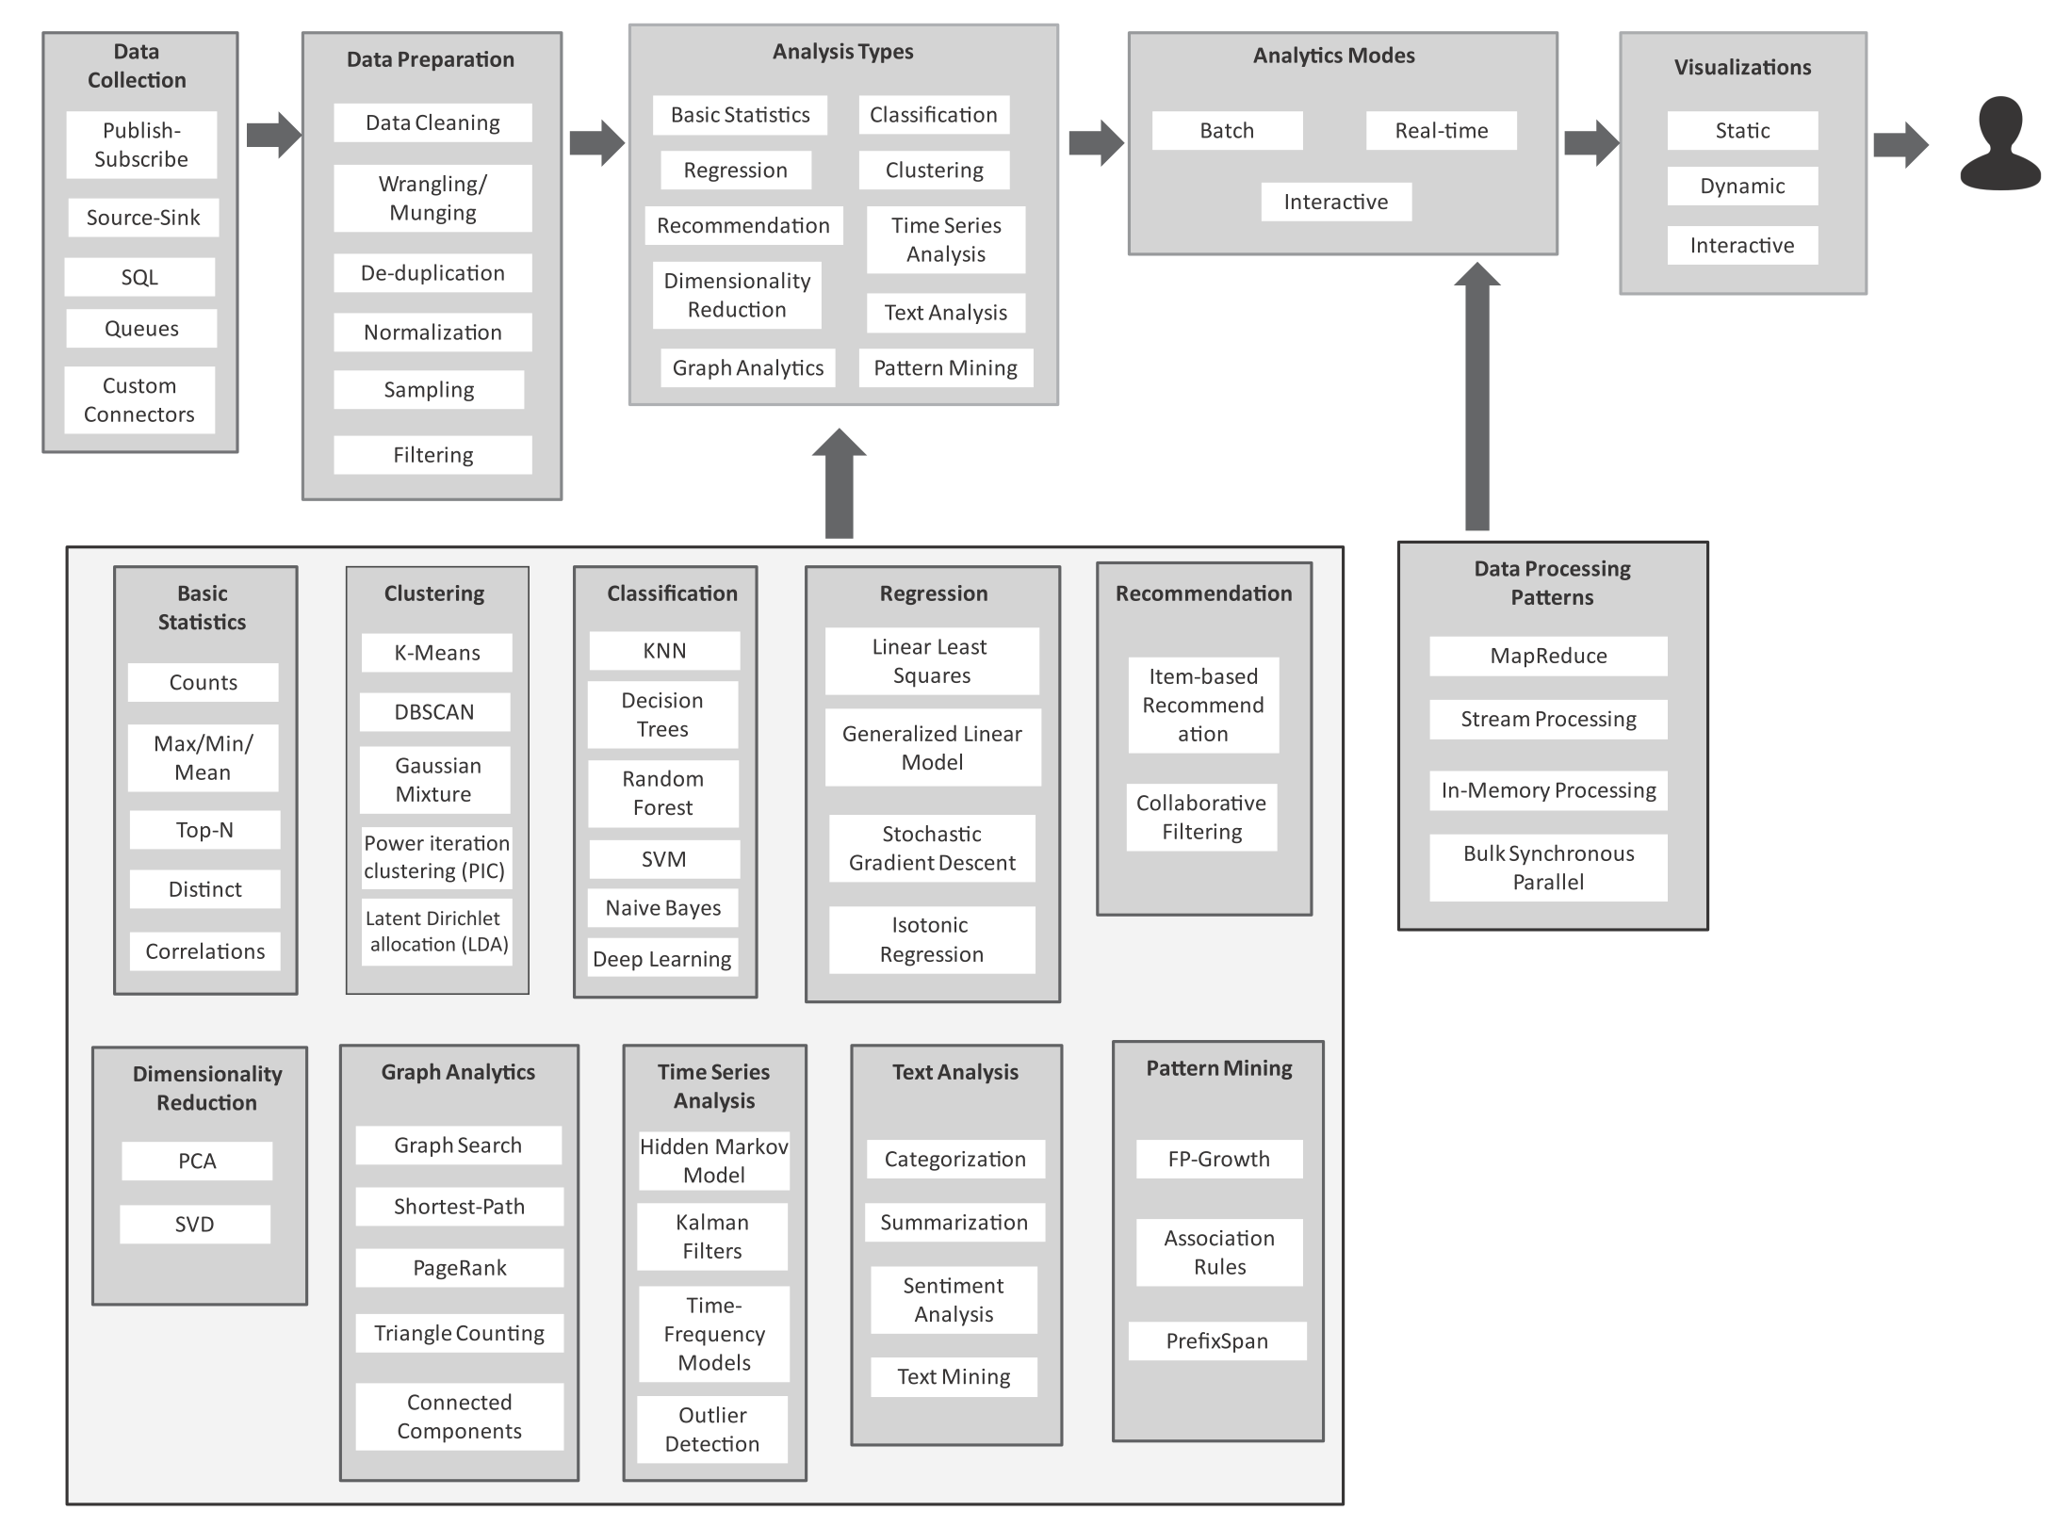
Analytics Flow for Big Data

Slide 8
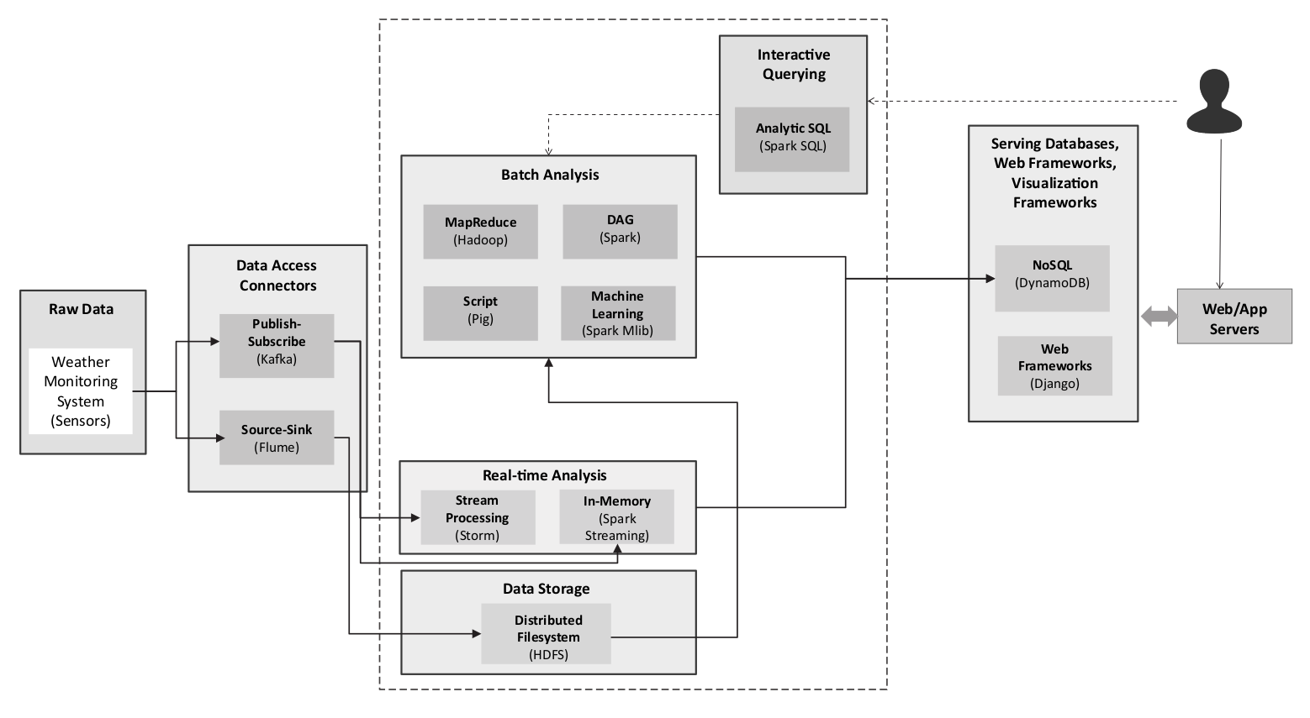
Big Data Stack
Chapter 8 - © 2019 Arshdeep Bahga & Vijay Madisetti

Slide 9
Big Data Stack
Raw Data Sources
In any big data analytics application or platform, before the data is processed and analyzed, it must be captured from the raw data sources into the big data systems and frameworks.
Data Access Connectors
The Data Access Connectors includes tools and frameworks for collecting and ingesting data from various sources into the big data storage and analytics frameworks. The choice of the data connector is driven by the type of the data source.
Data Storage
The data storage block in the big data stack includes distributed ﬁlesystems, relational and non-relational (NoSQL) databases, which store the data collected from the raw data sources using the data access connectors.

Slide 10
Big Data Stack
Batch Analytics
The batch analytics block in the big data stack includes various frameworks which allow analysis of data in batches such as Hadoop-MapReduce, Pig, Oozie, Pig, Spark, Solr.
Real-time Analytics
The real-time analytics block includes the Apache Storm, Nifi, and Spark Streaming frameworks.
Interactive Querying
Interactive querying systems allow users to query data by writing statements in SQL-like languages (e.g., Impala, Hive)
Serving Databases, Web & Visualization Frameworks
While the various analytics blocks process and analyze the data, the results are stored in serving databases for subsequent tasks of presentation and visualization. These serving databases allow the analyzed data to be queried and presented in the web applications.

Slide 11
What is a distributed file system?
How the operating system manages files is called a file system. How this information is stored on disk drives has a high impact on the efficiency and speed of access to data, especially in the big data case.
Commodity clusters are affordable parallel computers where the computing nodes are clustered in racks. Computing in one or more of these clusters across a local area network or the internet is called distributed computing. A cost-effective way of achieving data parallel scalability for big data applications (i.e., horizontal scaling).
Distributing data on multiple computers can be useful, but it raises new issues. Having a robust distributed file system can replicate the data between racks and computers across geographical regions.
Replicating data makes the system fault tolerant (e.g., if a rack or system goes down). The connectivity of a rack to the network can stop or the connections between individual nodes can break.

Slide 12
Hadoop
Hadoop at its core is a Java based software library which allows for distributed storage and parallel data-processing across a cluster of servers.
Hadoop is currently available either as a set of open-source packages or via several enterprise grade commercial distributions:
Apache Hadoop [open source]
Cloudera Enterprise | Cloudera CDH [open source] / Hortonworks Data Platform HDP [open source]
MapR, IBM Big Insights
Amazon Elastic MapReduce (EMR)
Microsoft Azure HDInsight
Google Cloud Dataproc
Hadoop core components serve as foundation for an entire ecosystem of data access and processing solutions.
Hadoop HDFS is a scalable, fault-tolerant, distributed storage system which stores data using native operating system files over a large cluster of nodes.
Hadoop YARN utilities for resource management across the cluster.

Slide 13
Hadoop (continued)
Hadoop is good for data parallelism. As you know, data parallelism is the simultaneous execution of the same function on multiple nodes across the elements of a dataset.
The Hadoop Distributed File System: HDFS replicates, or makes a copy of, file blocks on different nodes to prevent data loss. By default, HDFS maintains three copies of every block.
HDFS is comprised of two components: NameNode, and DataNode.The data node listens to commands from the namenode for block creation, deletion, and replication.
Replication provides two key capabilities. Fault tolerance and data locality. The default replication factor is three (copies). The location is important since we want to move computation to data and not the other way around. A high replication factor means more protection against hardware failures, and better chances for data locality. But it also means increased storage space and more coordination.

Slide 14
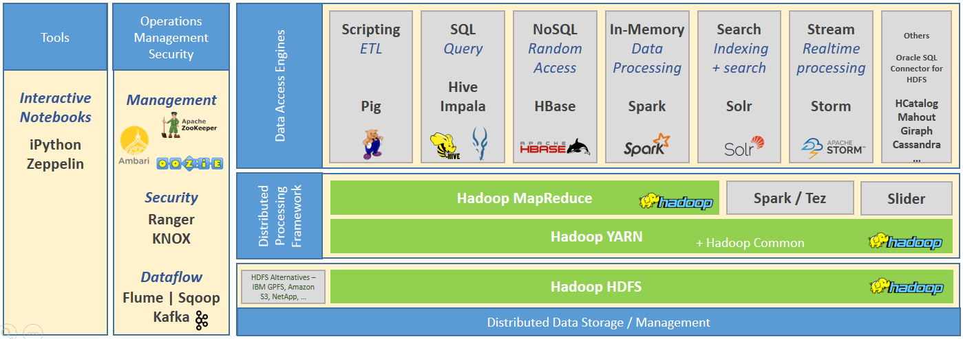
Hadoop Ecosystem
Image source: https://blogs.sap.com/2017/07/19/bridging-two-worlds-integration-of-sap-and-hadoop-ecosystems/

Slide 15
MapReduce
MapReduce is a programming model for the Hadoop ecosystem. It relies on YARN to schedule and execute parallel processing over the distributed file blocks in HDFS.
There are several tools that use the MapReduce model to provide a higher-level interface to other programming models. For example (previous slide) Hive has a SQL-like interface that adds capabilities that help with relational data modeling.
The MapReduce programming model greatly simplifies running code in parallel since you only need to create map and reduce tasks, and you don't have to worry about multiple threads, synchronization, or concurrency issues.
In Map and reduce the output is based on the input through some function (y = f(x)). You provide a function, or operation for a map, and reduce. And the runtime executes it over the data. For map, the operation is applied on each data element. And in reduce, the operation summarizes elements in some manner.

Slide 16
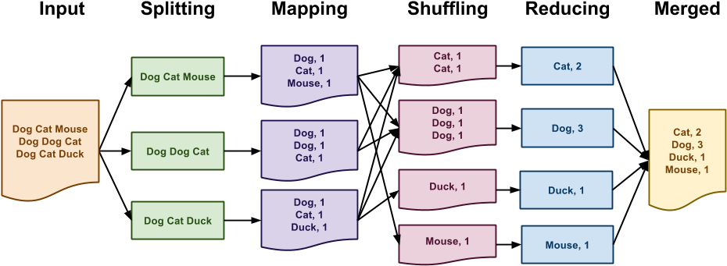
MapReduce: Example
Output

Slide 17
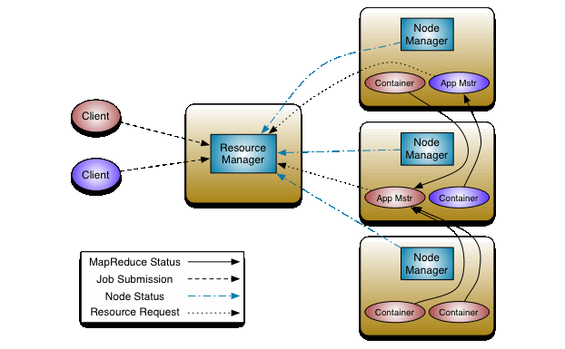
YARN Infrastructure
YARN (Yet Another Resource Negotiator) is a resource manager, created by separating the processing engine and the management function of MapReduce. Introduced in Hadoop v2.x.
YARN manages workloads, maintains a multi-tenant environment, manages the high availability features of Hadoop, and implements security controls.
The idea is to have a global ResourceManager (RM) and per-application ApplicationMaster (AM).
The ResourceManager (RM) arbitrates resources among all the applications in the system [scheduler + AppManager]
The NodeManager (per machine) is responsible for containers, monitoring their resource usage (cpu, memory, disk, network) and reporting to the ResourceManager/Scheduler.
The per-application ApplicationMaster negotiates resources from the ResourceManager and working with the NodeManager(s) to execute and monitor the tasks.
Source: https://hadoop.apache.org/docs/stable/hadoop-yarn/hadoop-yarn-site/YARN.html

Slide 18
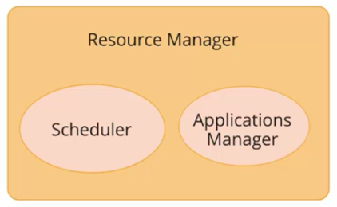
Resource Manager
The ResourceManager (RM) arbitrates resources among all the applications in the system [scheduler + AppManager]
The scheduler is responsible for allocating resources to various running applications
Most used schedulers include the Capacity scheduler, FIFO scheduler, and Fair scheduler.
The ApplicationsManager is an interface which maintains a list of applications that have been submitted, currently, running, or completed.
It accepts job submissions and negotiates the first container for executing the application and restarts the ApplicationMaster container on failure.

Slide 19
How YARN runs an application
Client submits an application to the ResourceManager
The ResourceManager allocates a container
The ApplicationMaster contacts the related NodeManager to launch an application-specific task
The NodeManager launches the container. NM does not monitor tasks; it monitors resource usage in the containers
The container executes the ApplicationMaster, who monitors the progress of an application and its tasks and reports back to client

Slide 20
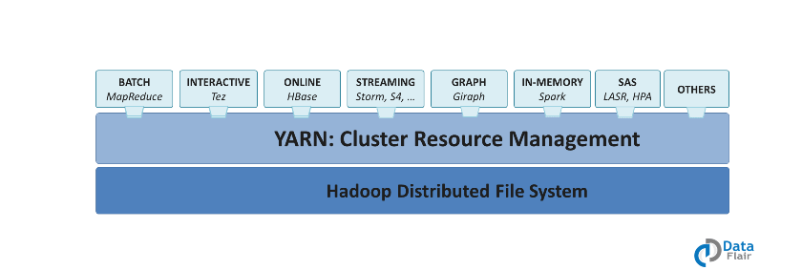
Applications on YARN
There can be many different workloads running on Hadoop YARN cluster
Source: https://data-flair.training/blogs/hadoop-yarn-tutorial/
It enables Hadoop to process other purpose-built data processing system other than MapReduce. It allows running several different frameworks on the same hardware where Hadoop is deployed.

Slide 21
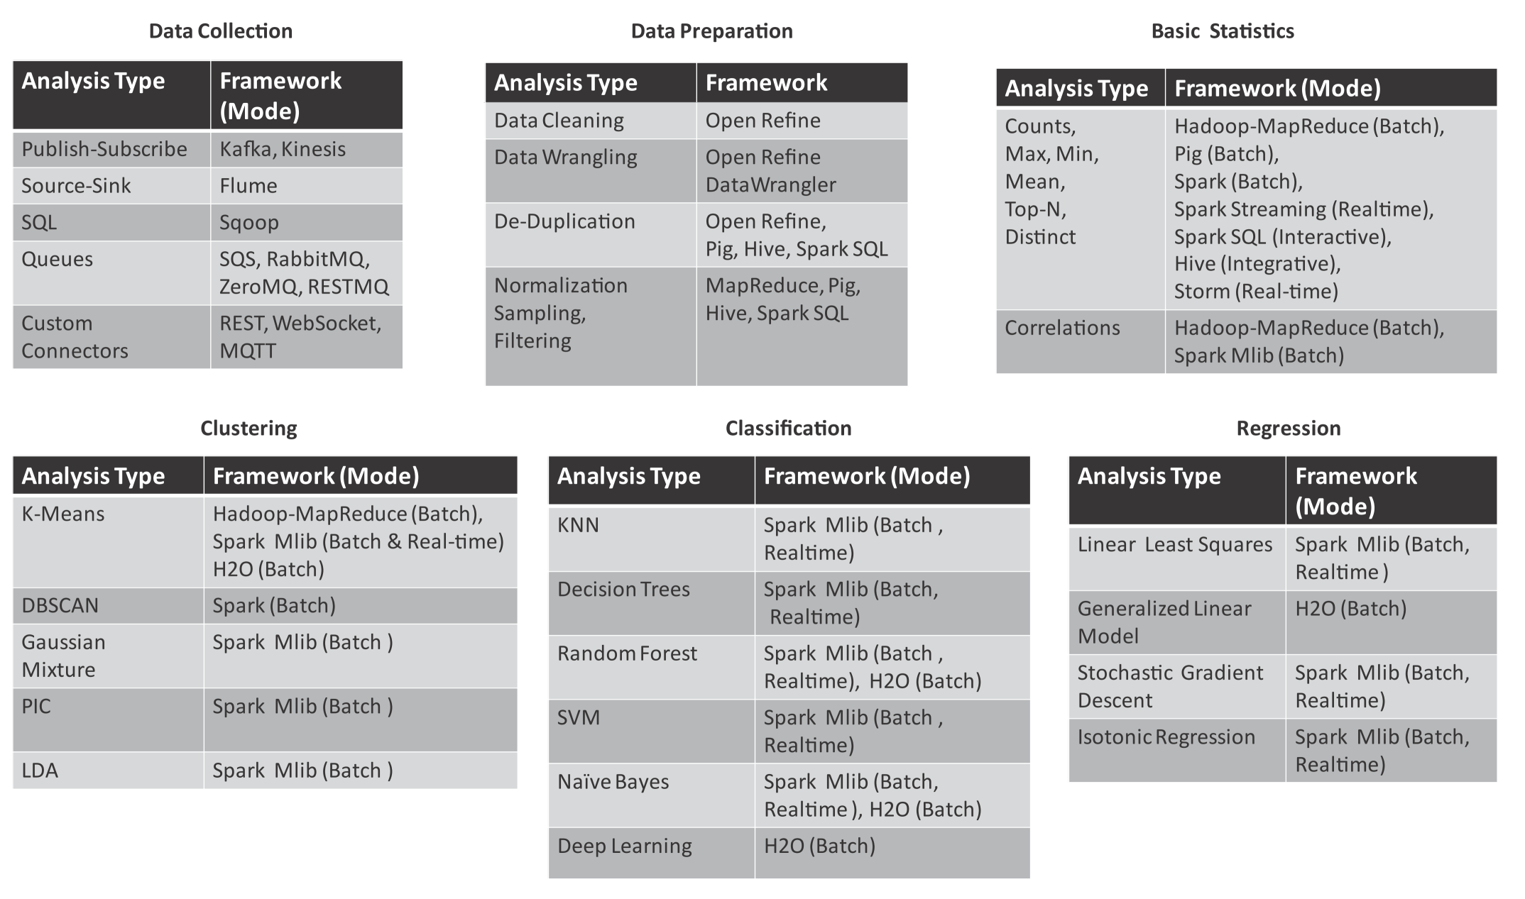
Mapping Analytics Flow to Big Data Stack
Chapter 8 - © 2019 Arshdeep Bahga & Vijay Madisetti

Slide 22
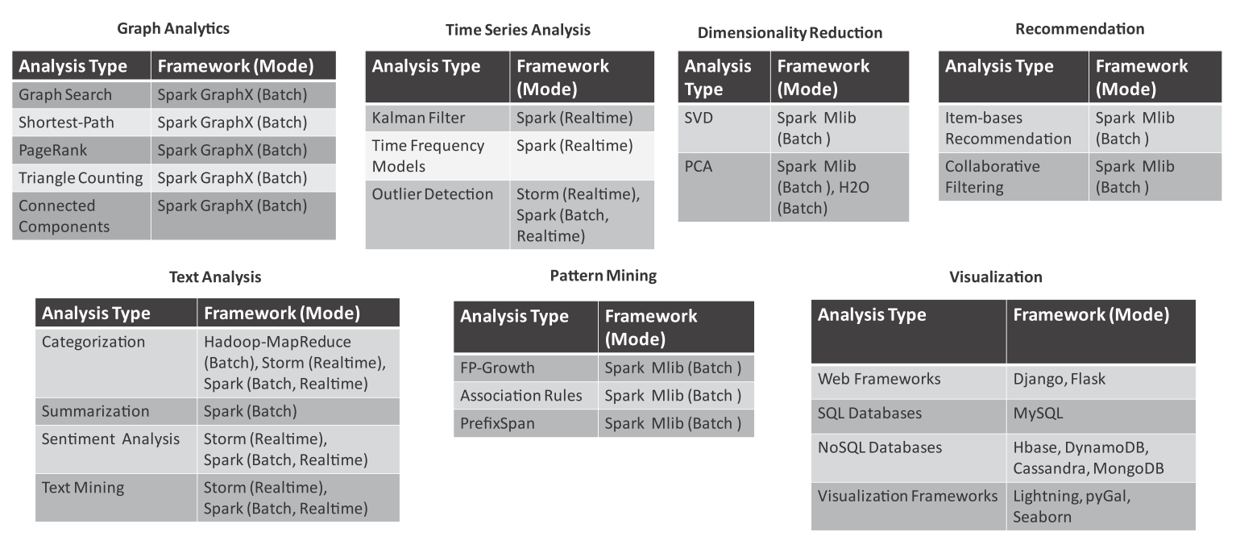
Mapping Analytics Flow to Big Data Stack
Chapter 8 - © 2019 Arshdeep Bahga & Vijay Madisetti

Slide 23
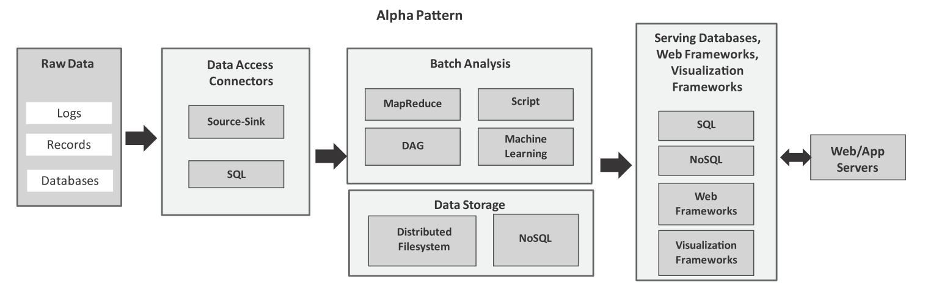
Analytics Patterns: alpha pattern
Alpha pattern
This pattern can be used for ingesting large volumes of data into a distributed ﬁlesystem (such as HDFS) or a NoSQL database (such as HBase) using source-sink connectors (such as Flume) and SQL connectors (such as Sqoop). After the data is moved to the stack, the data can be analyzed in batch mode with batch analysis frameworks including MapReduce (using Hadoop), scripting frameworks (such as Pig), distributed acyclic graph frameworks (such as Spark), machine learning frameworks (such as Spark MLlib). The analysis results are stored either in relational or non-relational databases.
Chapter 8 - © 2019 Arshdeep Bahga & Vijay Madisetti

Slide 24
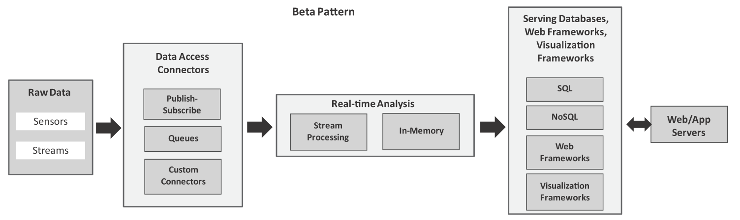
Analytics Patterns: alpha pattern
Beta pattern
This pattern can be used for ingesting streaming data using publish-subscribe messaging frameworks, queues and custom connectors. For real-time analysis, we can use stream processing frameworks (such as Storm) or in-memory processing frameworks (such as Spark).
Chapter 8 - © 2019 Arshdeep Bahga & Vijay Madisetti

Slide 25
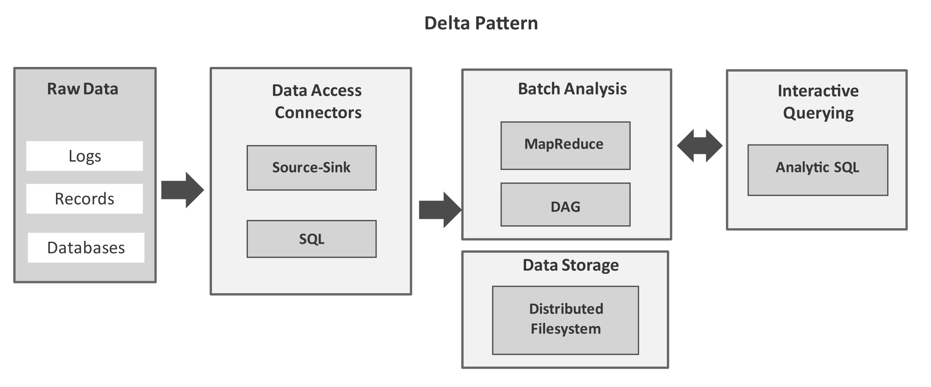
Analytics Patterns: alpha pattern
Delta pattern
This pattern uses, source-sink connectors (such as Flume) or SQL connectors (such as Sqoop) to ingest bulk data into the big data stack. After the data is moved to a distributed ﬁlesystem, you can use interactive querying frameworks (such as Hive or Spark SQL) for querying data with SQL-like queries in an interactive mode.
Chapter 8 - © 2019 Arshdeep Bahga & Vijay Madisetti

Slide 26
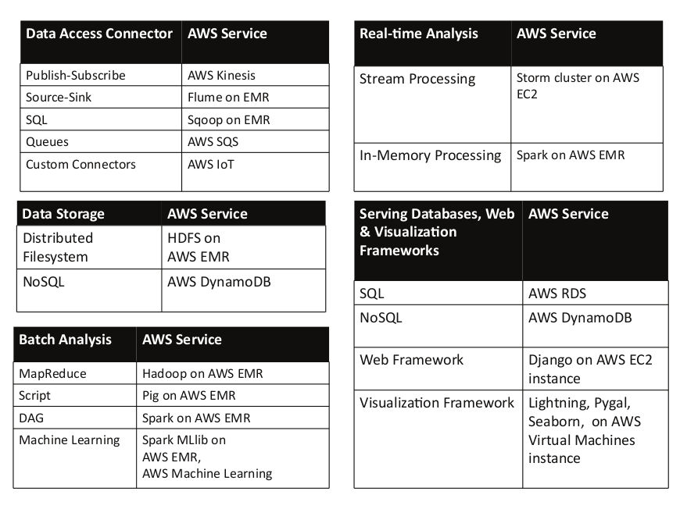
Mapping analytics patterns to AWS

Slide 27
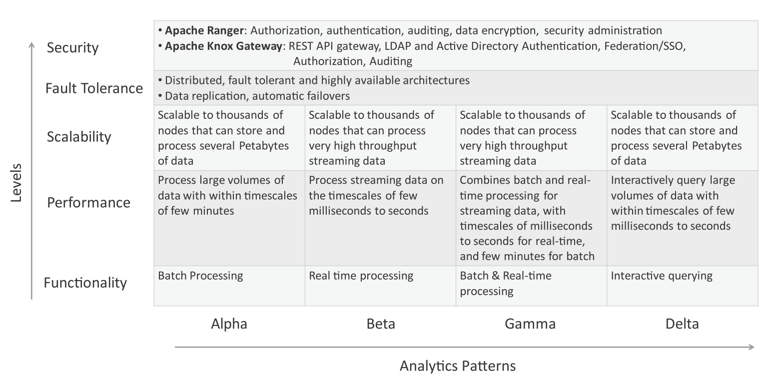
Complexity levels for analytics patterns

